Slide 1
3. The Logic of Quantified Statements
Sequences Mathematical Induction I Mathematical Induction II Well-Ordering Principle Recurrence Relations
8. Mathematical Induction
Aaron Tan
AY2022/23 Semester 1

Slide 2
Sequences Mathematical Induction I Mathematical Induction II Well-Ordering Principle Recurrence Relations
Mathematical Induction
A very powerful method for showing a property is true for national numbers (0, 1, 2, 3, …)
It characterizes the natural numbers (by Dedekind-Peano axioms).
Importance of Mathematical Induction in Computer Science
Mathematical induction (MI) plays a central role in discrete mathematics and computer science. It is a defining characteristics of discrete mathematics.
MI and recursion are closely linked. Hence, proof of correctness for recursive algorithms are usually done with MI.
Natural generalizations of induction characterize recursively defined objects.

Slide 3
Sequences Mathematical Induction I Mathematical Induction II Well-Ordering Principle Recurrence Relations
8. Mathematical Induction
8.1 Sequences
Definitions: Sequence, term, explicit formula.
8.2 Mathematical Induction I
Principle of mathematical induction
Change of variable; some common sequences.
8.3 Mathematical Induction II
Strong mathematical induction
Example: Any integer > 1 is divisible by a prime number
Summation notation; product notation; properties of summations and products.
Examples: Sum of first n integers, sum of a geometric sequence
8.4 Well-Ordering Principle
Well-ordering principle for the integers
8.5 Recurrence Relations
Definition
Recursively defined sets
Structural induction
Reference: Epp’s Chapter 5 Sequences, Mathematical Induction and Recursion

Slide 4
Sequences Mathematical Induction I Mathematical Induction II Well-Ordering Principle Recurrence Relations
8.1 Sequences

Slide 5
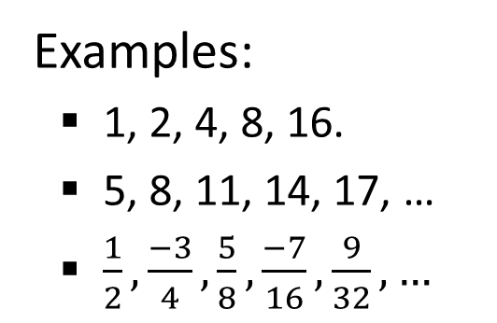
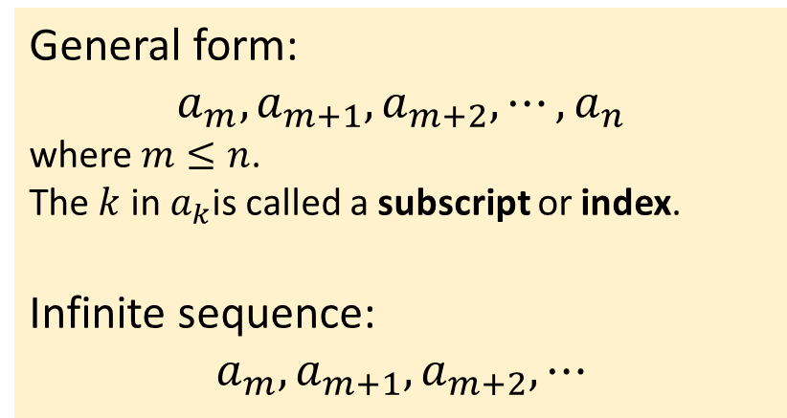
Sequences Mathematical Induction I Mathematical Induction II Well-Ordering Principle Recurrence Relations
Sequences: Definitions
8.1.1. Definitions
Definitions: Sequence and Terms
5.1 Sequences
A sequence is an ordered set with members called terms.
Usually, the terms are numbers. A sequence may have infinite terms.
Examples:
1, 2, 4, 8, 16.
5, 8, 11, 14, 17, …
$\frac{1}{2},\frac{−3}{4},\frac{5}{8},\frac{−7}{16},\frac{9}{32}, …$
General form:
$$a_{m},a_{m+1},a_{m+2},⋯,a_{n}$$
where $m≤n$.
The $k$ in $a_{k}$is called a subscript or index.
Infinite sequence:
$$a_{m},a_{m+1},a_{m+2},⋯$$

Slide 6
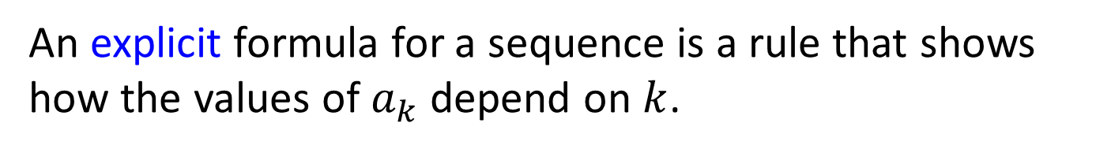
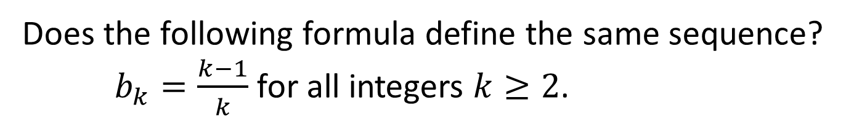
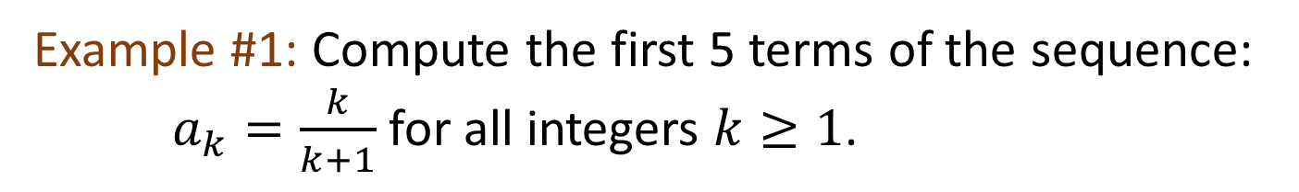
Sequences Mathematical Induction I Mathematical Induction II Well-Ordering Principle Recurrence Relations
Sequences: Closed-form Formula
An explicit formula for a sequence is a rule that shows how the values of $a_{k}$ depend on $k$.
Example #1: Compute the first 5 terms of the sequence: $a_{k}=\frac{k}{k+1}$ for all integers $k≥1$.
5.1 Sequences
Does the following formula define the same sequence? $b_{k}=\frac{k−1}{k}$ for all integers $k≥2$.


Slide 7
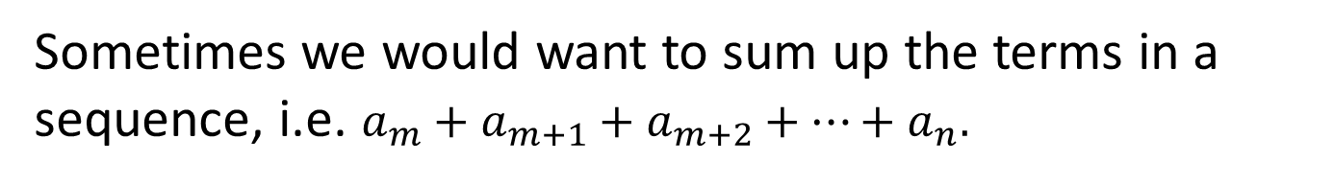

Sequences Mathematical Induction I Mathematical Induction II Well-Ordering Principle Recurrence Relations
Sequences: Summation Notation
8.1.2. Summation Notation
Sometimes we would want to sum up the terms in a sequence, i.e. $a_{m}+a_{m+1}+a_{m+2}+⋯+a_{n}.$
Definition: Summation
If $m$ and $n$ are integers, $m≤n$, the symbol
$$\sum_{k=m}^{n}{a_{k}}$$
is the sum of all the terms $a_{m},a_{m+1},a_{m+2},⋯,a_{n}.$
We say that $a_{m}+a_{m+1}+a_{m+2}+⋯+a_{n}$ is the expanded form of the sum, and we write
$\sum_{k=m}^{n}{a_{k}}=$ $a_{m}+a_{m+1}+a_{m+2}+⋯+a_{n}$.
We call $k$ the index of the summation, $m$ the lower limit of the summation and $n$ the upper limit of the summation.

Slide 8
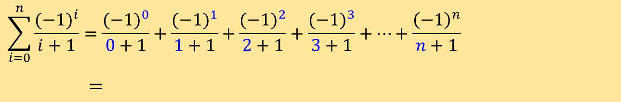
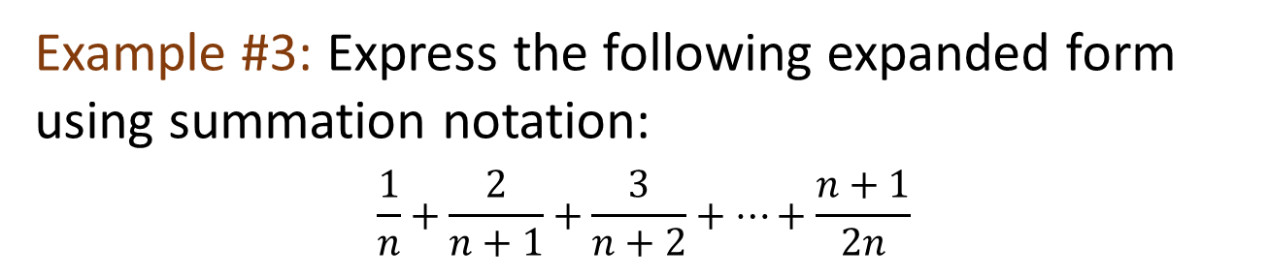

Sequences Mathematical Induction I Mathematical Induction II Well-Ordering Principle Recurrence Relations
Sequences: Summation Notation
Example #2: Write the following summation in expanded form:
$$\sum_{i=0}^{n}{\frac{{(−1)}^{i}}{i+1}}$$
$$\sum_{i=0}^{n}{\frac{{(−1)}^{i}}{i+1}}=\frac{{(−1)}^{0}}{0+1}+\frac{{(−1)}^{1}}{1+1}+\frac{{(−1)}^{2}}{2+1}+\frac{{(−1)}^{3}}{3+1}+⋯+\frac{{\left(−1\right)}^{n}}{n+1}$$
$=$
Example #3: Express the following expanded form using summation notation:
$$\frac{1}{n}+\frac{2}{n+1}+\frac{3}{n+2}+⋯+\frac{n+1}{2n}$$


Slide 9
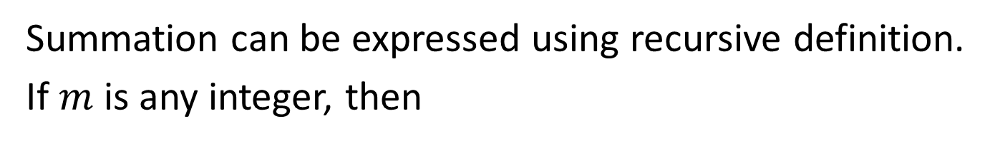
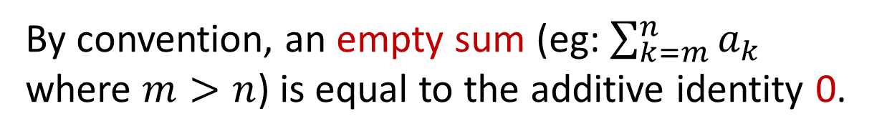
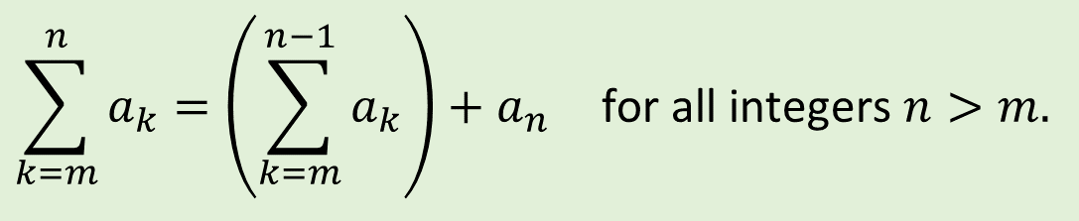
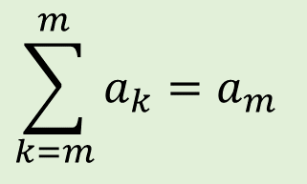
Sequences Mathematical Induction I Mathematical Induction II Well-Ordering Principle Recurrence Relations
Sequences: Summation Notation
Summation can be expressed using recursive definition.
If $m$ is any integer, then
$$\sum_{k=m}^{m}{a_{k}=a_{m}}$$
and
$$\sum_{k=m}^{n}{a_{k}={\left(\sum_{k=m}^{n−1}{a_{k}}\right)+a}_{n}} \text{for} \text{all} \text{integers} n>m.$$
By convention, an empty sum (eg: $\sum_{k=m}^{n}{a_{k}}$ where $m>n$) is equal to the additive identity 0.

Slide 10
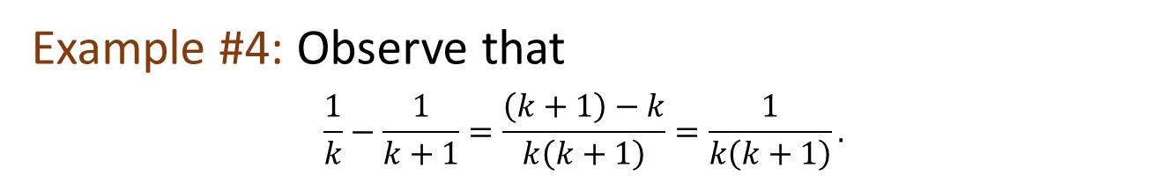
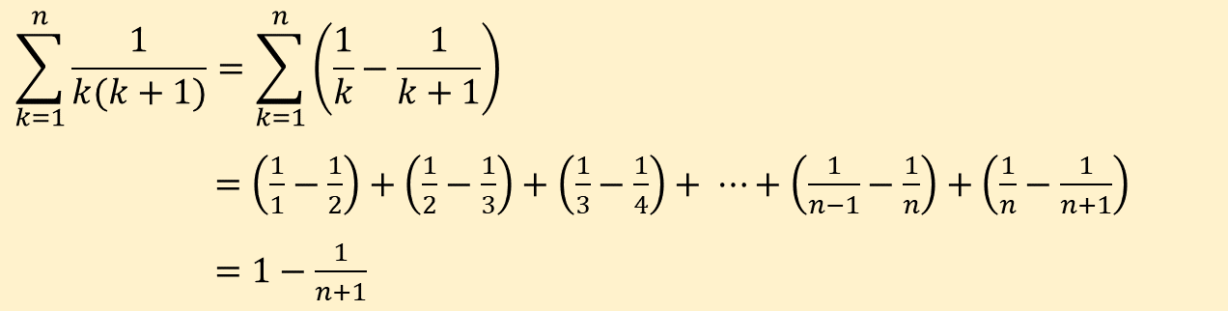
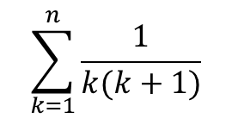
Sequences Mathematical Induction I Mathematical Induction II Well-Ordering Principle Recurrence Relations
Sequences: Summation Notation
Some sums can be transformed into telescoping sums, which then can be rewritten as a simple expression.
Example #4: Observe that
$$\frac{1}{k}−\frac{1}{k+1}=\frac{\left(k+1\right)−k}{k\left(k+1\right)}=\frac{1}{k\left(k+1\right)}.$$
$$\sum_{k=1}^{n}{\frac{1}{k(k+1)}}$$
Use the above to find a simple expression for
$$\sum_{k=1}^{n}{\frac{1}{k(k+1)}}=\sum_{k=1}^{n}{\left(\frac{1}{k}−\frac{1}{k+1}\right)}$$
$=\left(\frac{1}{1}−\frac{1}{2}\right)+\left(\frac{1}{2}−\frac{1}{3}\right)+\left(\frac{1}{3}−\frac{1}{4}\right)+ ⋯+\left(\frac{1}{n−1}−\frac{1}{n}\right)+\left(\frac{1}{n}−\frac{1}{n+1}\right)$
$=1−\frac{1}{n+1}$

Slide 11
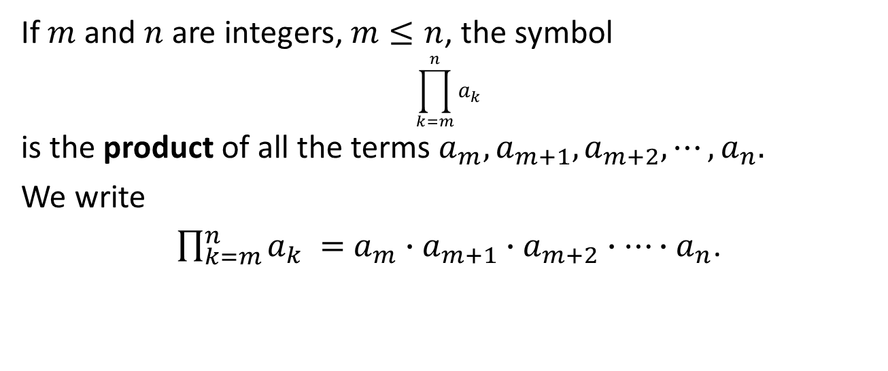
Sequences Mathematical Induction I Mathematical Induction II Well-Ordering Principle Recurrence Relations
Sequences: Product Notation
8.1.3. Product Notation
The notation for the product of a sequence of numbers is analogous to the notation for their sum.
Definition: Product
If $m$ and $n$ are integers, $m≤n$, the symbol
$$\prod_{k=m}^{n}{a_{k}}$$
is the product of all the terms $a_{m},a_{m+1},a_{m+2},⋯,a_{n}.$
We write
$\prod_{k=m}^{n}{a_{k}} =$ $a_{m}∙a_{m+1}∙a_{m+2}∙⋯∙a_{n}$.

Slide 12
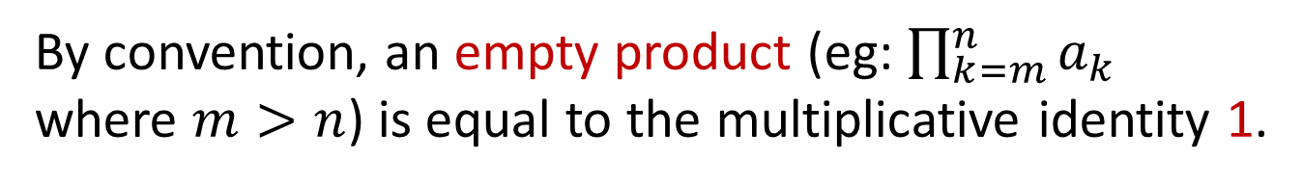
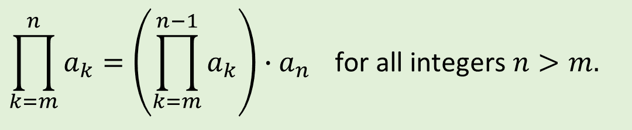
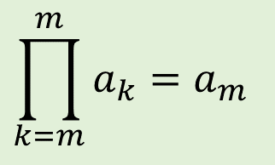
Sequences Mathematical Induction I Mathematical Induction II Well-Ordering Principle Recurrence Relations
Sequences: Product Notation
Recursive definition for the product notation:
If $m$ is any integer, then
$$\prod_{k=m}^{m}{a_{k}=a_{m}}$$
and
$$\prod_{k=m}^{n}{a_{k}=\left(\prod_{k=m}^{n−1}{a_{k}}\right)∙a_{n}} \text{for} \text{all} \text{integers} n>m.$$
By convention, an empty product (eg: $\prod_{k=m}^{n}{a_{k}}$ where $m>n$) is equal to the multiplicative identity 1.

Slide 13
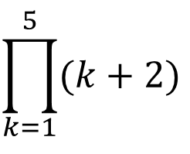
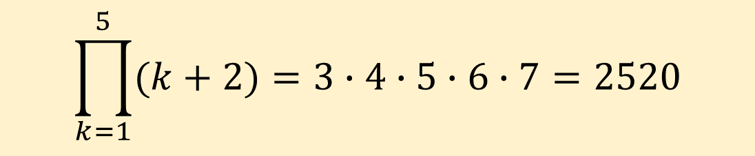
Sequences Mathematical Induction I Mathematical Induction II Well-Ordering Principle Recurrence Relations
Sequences: Product Notation
$$\prod_{k=1}^{5}{(k+2)}$$
Example #5: Compute the product
$$\prod_{k=1}^{5}{(k+2)}=3∙4∙5∙6∙7=2520$$

Slide 14

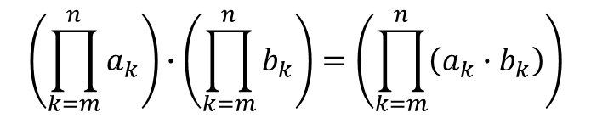
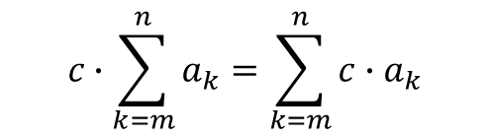
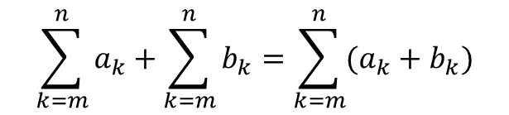
Sequences Mathematical Induction I Mathematical Induction II Well-Ordering Principle Recurrence Relations
Sequences: Properties of Summations and Products
8.1.4. Properties of Summations and Products
Theorem 5.1.1
If $a_{m},a_{m+1},a_{m+2},⋯$ and $b_{m},b_{m+1},b_{m+2},⋯$ are sequences of real numbers and $c$ is any real number , then the following equations hold for any integer $n≥m$:
$$\sum_{k=m}^{n}{a_{k}+\sum_{k=m}^{n}{b_{k}}=\sum_{k=m}^{n}{(a_{k}+b_{k})}}$$
$$c∙\sum_{k=m}^{n}{a_{k}=\sum_{k=m}^{n}{c∙a_{k}}}$$
(generalized distributive law)
$$\left(\prod_{k=m}^{n}{a_{k}}\right)∙\left(\prod_{k=m}^{n}{b_{k}}\right)=\left(\prod_{k=m}^{n}{\left(a_{k}∙b_{k}\right)}\right)$$

Slide 15
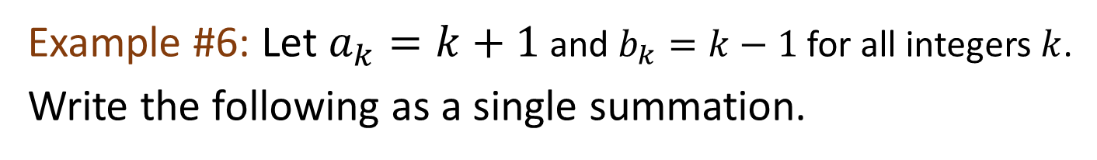
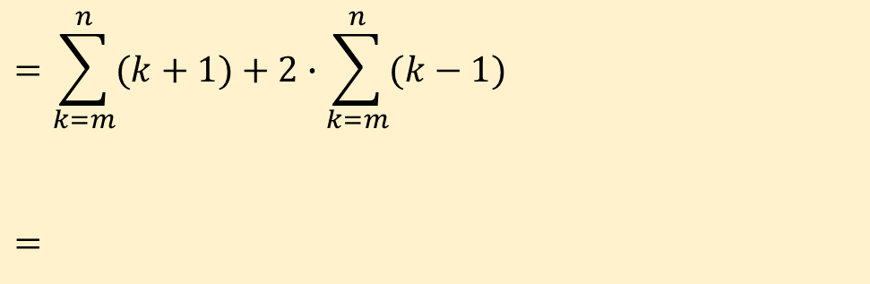
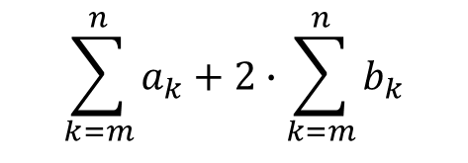
Sequences Mathematical Induction I Mathematical Induction II Well-Ordering Principle Recurrence Relations
Sequences: Properties of Summations and Products
Example #6: Let $a_{k}=k+1$ and $b_{k}=k−1$ for all integers $k$.
Write the following as a single summation.
$$\sum_{k=m}^{n}{a_{k}+2∙\sum_{k=m}^{n}{b_{k}}}$$
$$=\sum_{k=m}^{n}{(k+1)+2∙\sum_{k=m}^{n}{(k−1)}}$$
$$=$$
(a)
(by substitution)


Slide 16
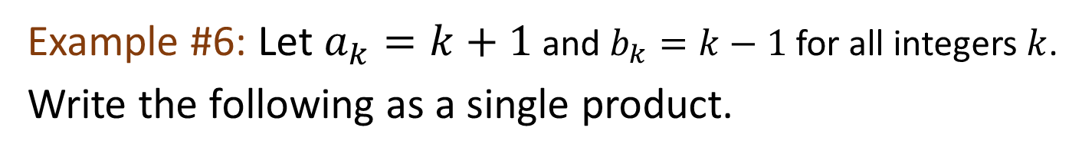
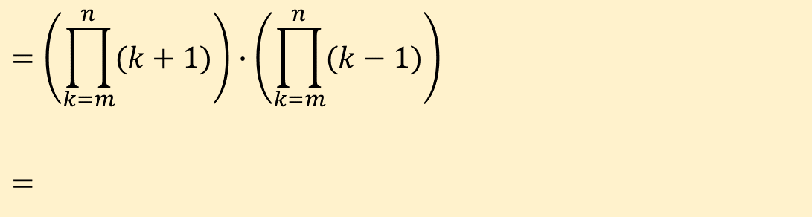
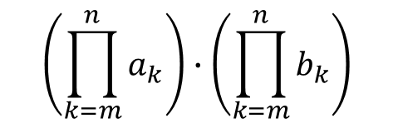
Sequences Mathematical Induction I Mathematical Induction II Well-Ordering Principle Recurrence Relations
Sequences: Properties of Summations and Products
Example #6: Let $a_{k}=k+1$ and $b_{k}=k−1$ for all integers $k$.
Write the following as a single product.
$$\left(\prod_{k=m}^{n}{a_{k}}\right)∙\left(\prod_{k=m}^{n}{b_{k}}\right)$$
(b)
$$=\left(\prod_{k=m}^{n}{(k+1)}\right)∙\left(\prod_{k=m}^{n}{(k−1)}\right)$$
$$=$$
(by substitution)


Slide 17
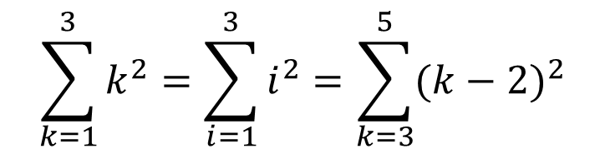
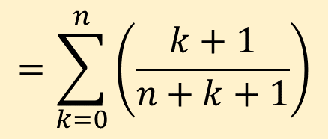
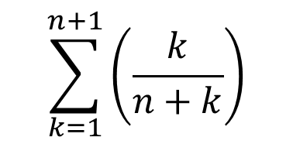
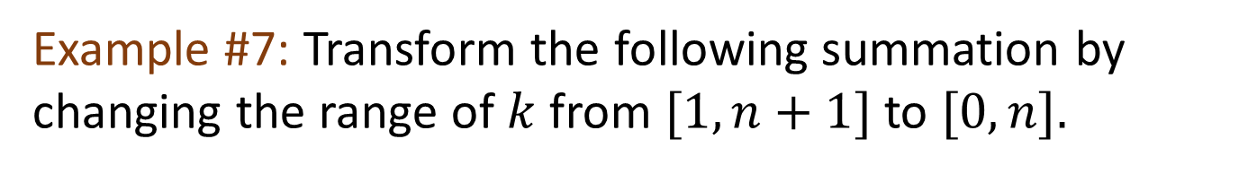
Sequences Mathematical Induction I Mathematical Induction II Well-Ordering Principle Recurrence Relations
Sequences: Change of Variable
8.1.5. Change of Variable
$$\sum_{k=1}^{3}{k^{2}}=\sum_{i=1}^{3}{i^{2}=\sum_{k=3}^{5}{{(k−2)}^{2}}}$$
Dummy variables
Example #7: Transform the following summation by changing the range of $k$ from $[1, n+1]$to $[0, n].$
$$\sum_{k=1}^{n+1}{\left(\frac{k}{n+k}\right)}$$
$$=\sum_{k=0}^{n}{\left(\frac{k+1}{n+k+1}\right)}$$

Slide 18
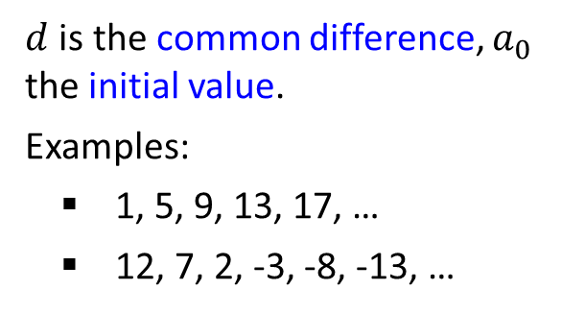
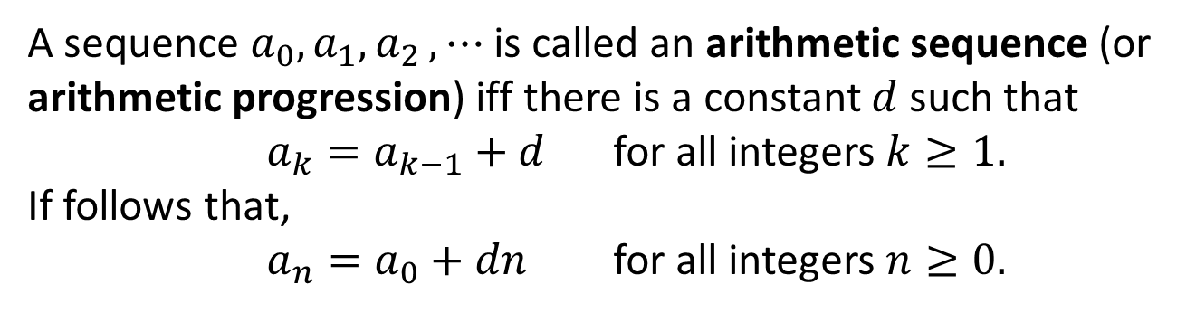
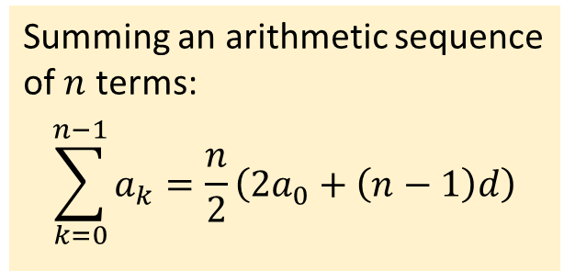
Sequences Mathematical Induction I Mathematical Induction II Well-Ordering Principle Recurrence Relations
Sequences: Some Common Sequences
8.1.6. Some Common Sequences
Definition: Arithmetic Sequence
A sequence $a_{0},a_{1}{,a}_{2},⋯$is called an arithmetic sequence (or arithmetic progression) iff there is a constant $d$ such that
$a_{k}=a_{k−1}+d$ for all integers $k≥1.$
If follows that,
$a_{n}=a_{0}+dn$ for all integers $n≥0.$
$d$ is the common difference, $a_{0}$ the initial value.
Examples:
1, 5, 9, 13, 17, …
12, 7, 2, -3, -8, -13, …
Summing an arithmetic sequence of $n$ terms:
$$\sum_{k=0}^{n−1}{a_{k}}=\frac{n}{2}\left(2a_{0}+\left(n−1\right)d\right)$$

Slide 19
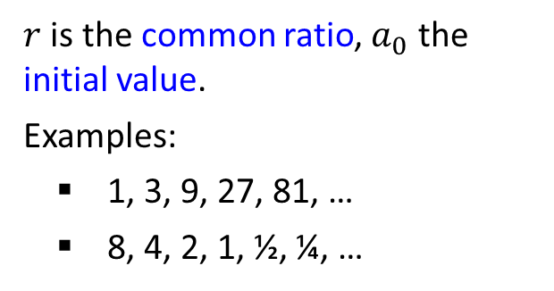
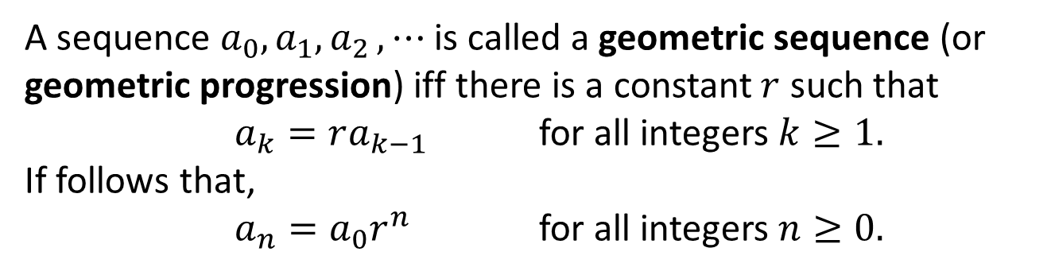
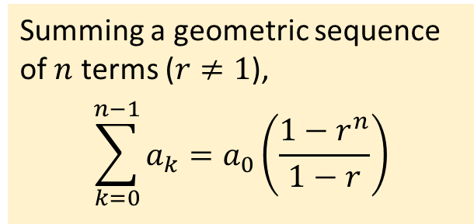
Sequences Mathematical Induction I Mathematical Induction II Well-Ordering Principle Recurrence Relations
Sequences: Some Common Sequences
Definition: Geometric Sequence
A sequence $a_{0},a_{1}{,a}_{2},⋯$is called a geometric sequence (or geometric progression) iff there is a constant $r$ such that
$a_{k}=ra_{k−1}$ for all integers $k≥1.$
If follows that,
$a_{n}=a_{0}r^{n}$ for all integers $n≥0.$
$r$ is the common ratio, $a_{0}$ the initial value.
Examples:
1, 3, 9, 27, 81, …
8, 4, 2, 1, ½, ¼, …
Summing a geometric sequence of $n$ terms ($r≠1$),
$$\sum_{k=0}^{n−1}{a_{k}}=a_{0}\left(\frac{1−r^{n}}{1−r}\right)$$

Slide 20
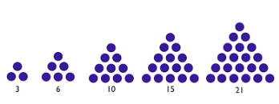
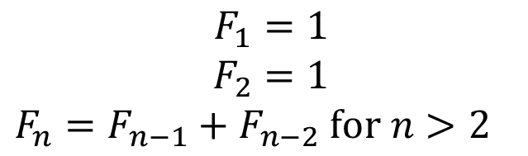
Sequences Mathematical Induction I Mathematical Induction II Well-Ordering Principle Recurrence Relations
Sequences: Some Common Sequences
Squares: 1, 4, 9, 16, 25, 36, 49, …
Triangle numbers: 1, 3, 6, 10, 15, 21, 28, …
Fibonacci numbers: 1, 1, 2, 3, 5, 8, 13, 21, 34, 55, …
$$F_{1}=1$$
$$F_{2}=1$$
$F_{n}=F_{n−1}+F_{n−2}$ $for n>2$
Lazy Caterer’s Sequence: 1, 2, 4, 7, 11, 16, …
(See AY2018/19 Semester 1 Exam Paper.)

Slide 21
Sequences Mathematical Induction I Mathematical Induction II Well-Ordering Principle Recurrence Relations
8.2 Mathematical Induction I

Slide 22

Sequences Mathematical Induction I Mathematical Induction II Well-Ordering Principle Recurrence Relations
Mathematical Induction I
8.2.1. Climbing an Infinite Ladder
How do you prove that you can climb an infinite ladder, even though you would never reach the top?
Show that
We can reach the first rung of the ladder;
If we can reach a particular rung, we can reach the next higher rung.

Slide 23
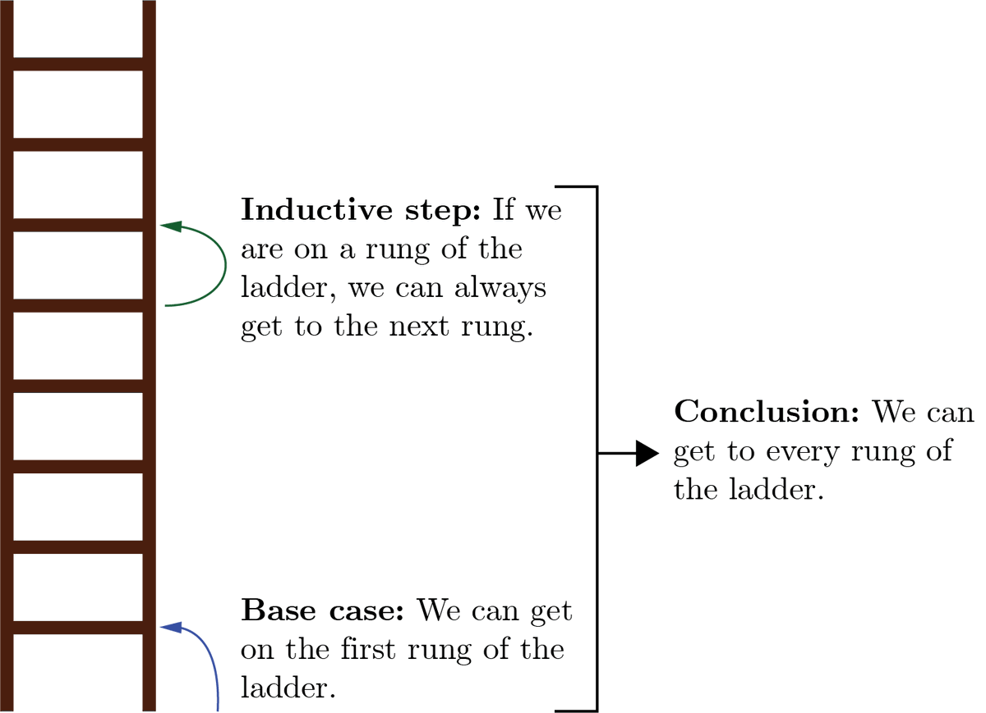
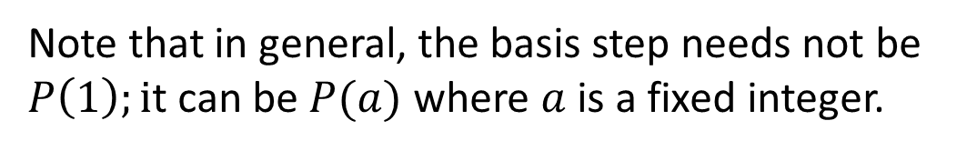
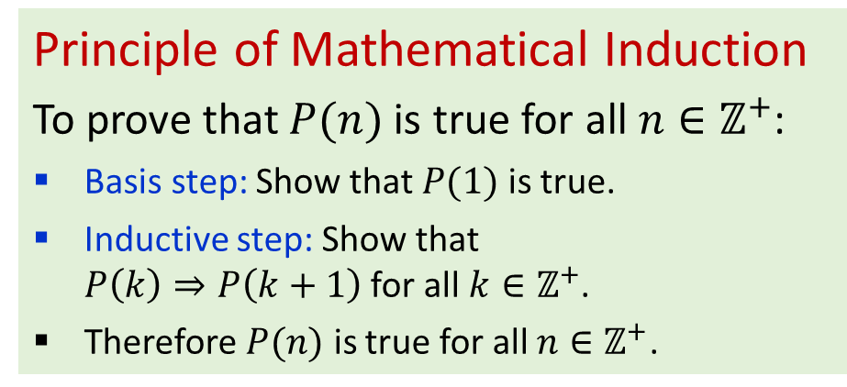
Sequences Mathematical Induction I Mathematical Induction II Well-Ordering Principle Recurrence Relations
Mathematical Induction I
Principle of Mathematical Induction
To prove that $P(n)$ is true for all $n∈ℤ^{+}$:
Basis step: Show that $P(1)$ is true.
Inductive step: Show that $P\left(k\right)⇒P\left(k+1\right)$ for all $k∈ℤ^{+}$.
Therefore $P(n)$ is true for all $n∈ℤ^{+}$.
Induction hypothesis
Note that in general, the basis step needs not be $P\left(1\right);i$t can be $P(a)$ where $a$ is a fixed integer.

Slide 24
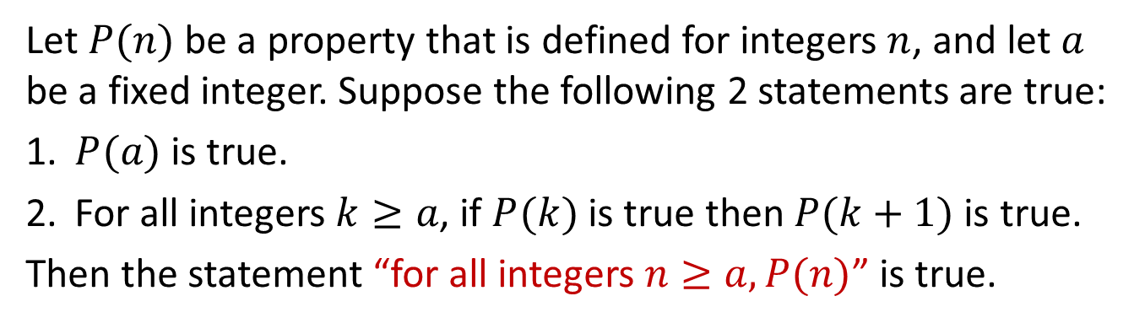
Sequences Mathematical Induction I Mathematical Induction II Well-Ordering Principle Recurrence Relations
Mathematical Induction I
8.2.2. Principle of Mathematical Induction (PMI)
Principle of Mathematical Induction (PMI)
Let $P(n)$ be a property that is defined for integers $n$, and let $a$ be a fixed integer. Suppose the following 2 statements are true:
1. $P(a)$ is true.
2. For all integers $k≥a$, if $P(k)$ is true then $P(k+1)$ is true.
Then the statement “for all integers $n≥a, P(n)$” is true.
The validity of proof by mathematical induction is generally taken as an axiom. That is why it is referred to as the principle of mathematical induction rather than as a theorem. We may use PMI as a short-form for Principle of Mathematical Induction.

Slide 25
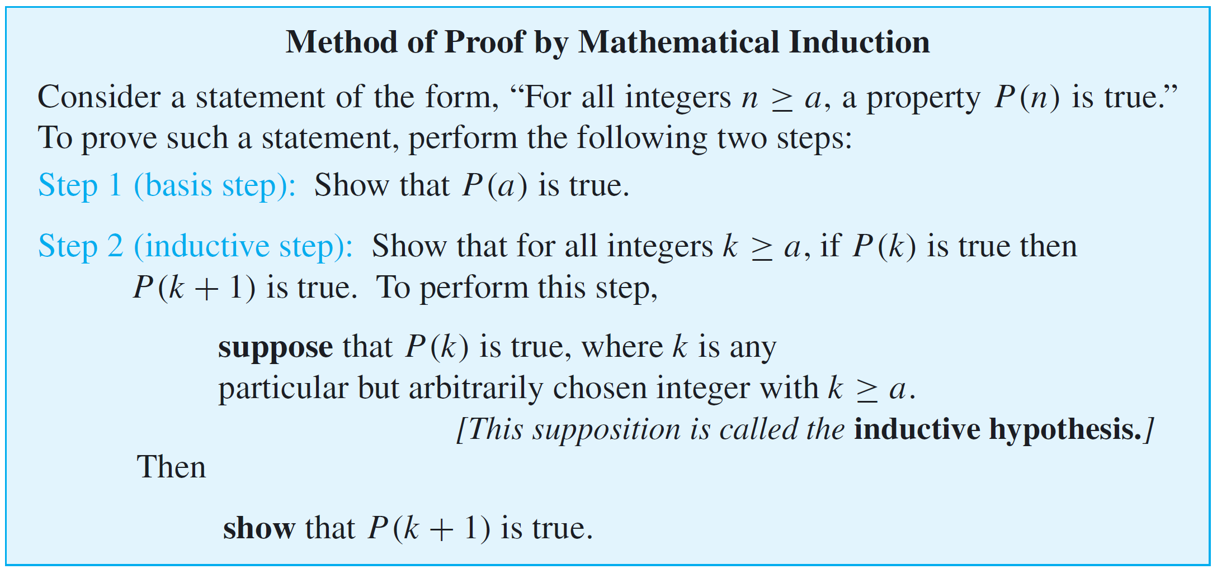
Sequences Mathematical Induction I Mathematical Induction II Well-Ordering Principle Recurrence Relations
Mathematical Induction I
Proving a statement by mathematical induction is a two-step process. The first step is called the basis step, and the second step is called the inductive step.

Slide 26



Sequences Mathematical Induction I Mathematical Induction II Well-Ordering Principle Recurrence Relations
Mathematical Induction I: Sum of the First $n$ Integers
Example #8: Use mathematical induction to prove
Theorem 5.2.2 (5th: 5.2.1) Sum of the First $n$ Integers
For all integers $n≥1,$
$1+2+3+⋯+n=\frac{n(n+1)}{2}$
Proof (by mathematical induction):
Let $P\left(n\right)≡ \left(1+2+⋯+n=\frac{n\left(n+1\right)}{2}\right), ∀n∈ℤ^{+}$. (Set up predicate.)
Basis step: $1=\frac{1(1+1)}{2}$, therefore $P(1)$ is true.
Assume $P(k)$ is true for some $k≥1.$ That is,
$$1+2+⋯+k=\frac{k(k+1)}{2}$$
Inductive step: (To show $P(k+1)$ is true.)
4.1. $1+2+⋯+k+\left(k+1\right)=\frac{k\left(k+1\right)}{2}+\left(k+1\right)=\frac{\left(k+1\right)\left(\left(k+1\right)+1\right)}{2}$
4.2. Therefore $P(k+1)$ is true.
5. (We have proved $P(1)$ and $P(k)→P(k+1)$) Therefore, $P(n)$ is true for $n∈ℤ^{+}$.
Text in green are comments that may be omitted in your solution.
How we make use of $P(k)$.

Slide 27

Sequences Mathematical Induction I Mathematical Induction II Well-Ordering Principle Recurrence Relations
Mathematical Induction I: Closed Form
Definition: Closed Form
If a sum with a variable number of terms is shown to be equal to a formula that does not contain either an ellipsis (…) or a summation symbol (Σ), we say that it is written in closed form.
Example:
$\frac{n(n+1)}{2}$ is the closed form formula for $1+2+3+ ⋯+n.$

Slide 28


Sequences Mathematical Induction I Mathematical Induction II Well-Ordering Principle Recurrence Relations
Mathematical Induction I: Sum of a Geometric Sequence
Example #9: Use mathematical induction to prove
Theorem 5.2.3 (5th: 5.2.2) Sum of a Geometric Sequence
For any real number $r≠1$, and any integers $n≥0,$
$$\sum_{i=0}^{n}{r^{i}}=\frac{r^{n+1}−1}{r−1}$$
Proof (by mathematical induction):
Let $P\left(n\right)≡ \left(\sum_{i=0}^{n}{r^{i}}=\frac{r^{n+1}−1}{r−1}\right), r≠1, n≥0$. (Set up predicate.)
Basis step: $r^{0}=1=\frac{r^{1}−1}{r−1}$, therefore $P(0)$ is true.
Assume $P(k)$ is true for $k≥0.$ That is, $\sum_{i=0}^{k}{r^{i}}=\frac{r^{k+1}−1}{r−1}$
Inductive step: (To show $P(k+1)$ is true.)
4.1. $\sum_{i=0}^{k+1}{r^{i}}=\sum_{i=0}^{k}{r^{i}}+r^{k+1}=\frac{r^{k+1}−1}{r−1}+r^{k+1}=\frac{r^{k+1}−1+r^{k+1}(r−1)}{r−1}$
$= \frac{r^{\left(\left(k+1\right)+1\right)}−1}{r−1}$
4.2. Therefore $P(k+1)$ is true.
5. Therefore, $P(n)$ is true for $n≥0$.

Slide 29

Sequences Mathematical Induction I Mathematical Induction II Well-Ordering Principle Recurrence Relations
Mathematical Induction I
Example #10: Use mathematical induction to prove
Proposition 5.3.1 (5th: 5.3.2)
For all integers $n≥0, 2^{2n}−1$ is divisible by 3.
Proof (by mathematical induction):
Let $P\left(n\right)≡\left(3 \right| (2^{2n}−1))$for all integers $n≥0$.
Basis step: $2^{2∙0}−1=0$ is divisible by 3, therefore $P(0)$ is true.
Assume $P(k)$ is true for $k≥0.$ That is, $3|(2^{2k}−1)$.
3.1 This means that $2^{2k}−1=3r$ for some integer $r$ (by defn of divisibility).
Inductive step: (To show $P(k+1)$ is true.)


Slide 30

Sequences Mathematical Induction I Mathematical Induction II Well-Ordering Principle Recurrence Relations
Mathematical Induction I
Example #11: Use mathematical induction to prove
Proposition 5.3.2 (5th: 5.3.3)
For all integers $n≥3, 2n+1<2^{n}$.
Proof (by mathematical induction):
Let $P\left(n\right)≡\left(2n+1<2^{n}\right), ∀n∈ℤ_{≥3}$.
Basis step: $2∙3+1=7<{8=2}^{3}$, therefore $P(3)$ is true.
Assume $P(k)$ is true for $k≥3.$ That is, $2k+1<2^{k}$.
Inductive step: (To show $P(k+1)$ is true.)


Slide 31

Sequences Mathematical Induction I Mathematical Induction II Well-Ordering Principle Recurrence Relations
Mathematical Induction I: A Negative Example
Example #12: A Negative Example
Claim: All cows have the same colour.

Slide 32

Sequences Mathematical Induction I Mathematical Induction II Well-Ordering Principle Recurrence Relations
Mathematical Induction I: A Negative Example
Example #12: A Negative Example
What is wrong with this proof?
Claim: All cows have the same colour.
Proof (by mathematical induction):
Let $P\left(n\right)≡$ (Any group of $n$ cows have the same colour), $∀n∈ℤ^{+}$
Basis step: Clearly, a single cow has one colour, so $P(1)$ is true.
Assume $P(k)$ is true for $k≥1.$
Inductive step: (To show $P(k+1)$ is true.)
4.1. In any group of $k+1$ cows, number them from 1 to $k+1$.
4.2. Then cows #1 to #$k$ form a group of $k$ cows, which have the same colour by the Inductive Hypothesis.
4.3. Similarly, cows #2 to #$k+1$ have the same colour.
4.4. Now, cows #2 to #$k$ are common to both groups, and cows don’t change colour!
4.5. Thus cow #$k+1$ has the same colour as cow #1, which means all $(k+1)$cows have the same colour.
4.6. Therefore, $P(k+1)$ is true.
5. Therefore, $P(n)$ is true, i.e., all cows have the same colour!

Slide 33




Sequences Mathematical Induction I Mathematical Induction II Well-Ordering Principle Recurrence Relations
Mathematical Induction I
Mathematical induction is not restricted to proving formulas.
Example #13: For $n∈ℤ^{+}$, any $2^{n}×2^{n}$ board with one square removed can be tiled by L-trominoes.
L-tromino
Proof (by mathematical induction):
1. Let $P\left(n\right)≡$ ($2^{n}×2^{n}$ board with one square removed can be tiled by L-trominoes), $∀n∈ℤ^{+}$.
2. Basis step: $P(1)$is true as such a board is an L-tromino.
3. Assume $P(k)$ is true for $k≥1.$
4. Inductive step: (To show $P(k+1)$ is true.)
4.1. Let $B$ be a $2^{k+1}×2^{k+1}$ board with one square removed.
4.2. Divide $B$ into four $2^{k}×2^{k}$ quadrants.
4.3. Let $Q$ be the quadrant containing the removed square.
4.4. Remove one L-tromino from the centre of $B$ such that each quadrant other than $Q$ has one square removed.
4.5. We have four $2^{k}×2^{k}$ quadrants, each with one square removed.
4.6. By the induction hypotheses, each quadrant can be tiled by L-trominoes.
4.7. Therefore, $P(k+1)$ is true.
5. Therefore $∀n∈ℤ^{+} P(n)$ is true$.$
$$2^{k+1}$$
$$2^{k}$$

Slide 34


Sequences Mathematical Induction I Mathematical Induction II Well-Ordering Principle Recurrence Relations
Mathematical Induction I
Exercise: This is a past year’s assignment question. Discuss on the LumiNUS forum.
$n$ red balls and $n$ blue balls ($n > 0$) are arranged to form a circle. You walk around the circle exactly once in a clockwise direction and count the number of red and blue balls you pass. If at all times during your walk, the number of red balls (that you have passed) is greater than or equal to the number of blue balls (that you have passed), then your trip is said to be successful. (Note that whether successful or not, you will pass exactly 2$n$ balls after walking one round.)
Define $P\left(n\right)≡$(In any circle formed by $n$ red and $n$ blue balls, there exists a successful trip), $∀n∈ℤ^{+}.$
Prove by mathematical induction that you can always make a successful trip if you can choose where you start.

Slide 35
Sequences Mathematical Induction I Mathematical Induction II Well-Ordering Principle Recurrence Relations
8.3 Mathematical Induction II

Slide 36

Sequences Mathematical Induction I Mathematical Induction II Well-Ordering Principle Recurrence Relations
Mathematical Induction II
8.3.1. Strong Mathematical Induction

Slide 37




Sequences Mathematical Induction I Mathematical Induction II Well-Ordering Principle Recurrence Relations
Mathematical Induction II
Comparison between “weak” and “strong” induction.
Let $P(n)$ denotes the property on all integers $n≥a$.
Weak (regular) induction (or 1PI)
If
$P(a)$holds
For every $k≥a, P\left(k\right)⇒P\left(k+1\right)$
Then $P(n)$ holds for all $n≥a$.
We may prove strong induction from weak and weak induction from strong (proofs omitted).
This means both types of induction are equal in “power”.
Hence, using more neutral terms, we can call the regular/strong versions the First Principle of Mathematical Induction (1PI) and Second Principle of Mathematical Induction (2PI) respectively.
Strong induction (or 2PI)
If
$P(a)$holds
For every $k≥a, \left(P\left(a\right)∧P\left(a+1\right)∧⋯P\left(k\right)\right)⇒P\left(k+1\right)$
Then $P(n)$ holds for all $n≥a$.
Strong induction (or 2PI) (variation – other variations possible)
If
$P\left(a\right),P\left(a+1\right),…,P(b)$hold
For every $k≥a, P\left(k\right)⇒P\left(k+b−a+1\right)$
Then $P(n)$ holds for all $n≥a$.
37

Slide 38
Sequences Mathematical Induction I Mathematical Induction II Well-Ordering Principle Recurrence Relations
Mathematical Induction II: Any integer > 1 is divisible by a prime number
Exercise #14: Prove that
Any integer > 1 is divisible by a prime number.
Idea: If a given integer greater than 1 is not itself prime, then it is a product of two smaller positive integers, each of which is greater than 1.
Since you are assuming that each of these smaller integers is divisible by some prime number, by transitivity of divisibility, those prime numbers also divide the integer you started with.
Theorem 4.3.3 (5th: 4.4.3) Transitivity of Divisibility
For all integers $a$, $b$ and $c$, if $a | b$and $b | c$, then $a | c$.

Slide 39

Sequences Mathematical Induction I Mathematical Induction II Well-Ordering Principle Recurrence Relations
Mathematical Induction II: Any integer > 1 is divisible by a prime number
Prove: Any integer greater than 1 is divisible by a prime number.
Proof (by 2PI):
1. Let $P\left(n\right)≡$ ($n$ is divisible by a prime), for $n>1$.
2. Basis step: $P(2)$is true since 2 is divisible by 2.
3. Inductive step: To show that for all integers $k≥2$, if $P(i)$ is true for all integers $i$ from 2 through $k$, then $P(k+1)$ is also true.
3.1. Case 1 ($k+1$ is prime): In this case $k+1$ is divisible by a prime number which is itself.
3.2. Case 2 ($k+1$ is not prime): In this case $k+1 = ab$where $a$ and $b$ are integers with $1<a<k+1$and $1<b<k+1$.
3.2.1. Thus, in particular, $2  a  k$and so by inductive hypothesis, $a$ is divisible by a prime number $p$.
3.2.2. In addition, because $k+1 = ab$, so $k+1$ is divisible by $a$.
3.2.3. By transitivity of divisibility, $k+1$ is divisible by a prime $p$.
4. Therefore any integer greater than 1 is divisible by a prime.

Slide 40


Sequences Mathematical Induction I Mathematical Induction II Well-Ordering Principle Recurrence Relations
Mathematical Induction II: Any amount $≥\$12$ can be formed by a combination of $4 and $5 coins
Example #15: Use 1PI to prove that any whole amount of $≥\$12$ can be formed by a combination of $4 and $5 coins.
Proof (by 1PI):
Let $P\left(n\right)≡$ (the amount of $$n$ can be formed by $4 and $5 coins) for $n≥12$.
Basis step: $12=3×4$, so three $4 can be used. Therefore $P(12)$ is true.
Assume $P(k)$ is true for $k≥12.$
Inductive step: (To show $P(k+1)$ is true.)
4.1. Case 1: If a $4 coin is used for $$k$ amount, replace it by a $5 coin to make $($k+1$).
4.2. Case 2: If no $4 coin is used for $$k$ amount, then $k≥15$, so there must be at least three $5 coins. We can then replace three $5 coins with four $4 coins to make $($k+1$).
4.3. In both cases, $P(k+1)$ is true.
5. Therefore, $P(n)$ is true for $n≥12$.

Slide 41


Sequences Mathematical Induction I Mathematical Induction II Well-Ordering Principle Recurrence Relations
Mathematical Induction II: Any amount $≥\$12$ can be formed by a combination of $4 and $5 coins
Example #16: Use 2PI to prove that:
For all integers $n≥12, n=4a+5b$ for some $a,b∈ℕ.$
Proof (by 2PI):
Let $P\left(n\right)≡\left(n=4a+5b\right),$ for some $a,b∈ℕ,$ $n≥12$.
Basis step: Show that $P\left(12\right),P\left(13\right),P\left(14\right),P(15)$ hold.
$12 = 4∙3+5∙0; 13 = 4∙2+5∙1; 14 = 4∙1+5∙2; 15 = 4∙0+5∙3;$
Assume $P(i)$ holds for $12≤i<k$ given some $k>15$.
Inductive step: (To show $P(k+1)$ is true.)
4.1. $P(k−3)$ holds (by induction hypothesis),
so, $k−3=4a+5b$ for some $a,b∈ℕ$
4.2. $k+1 = \left(k−3\right)+4 =\left(4a+5b\right)+4 =4\left(a+1\right)+5b$
4.3. Hence, $P(k+1)$ is true.
5. Therefore, $P(n)$ is true for $n≥12$.

Slide 42
Sequences Mathematical Induction I Mathematical Induction II Well-Ordering Principle Recurrence Relations
8.4 Well-Ordering Principle

Slide 43

Sequences Mathematical Induction I Mathematical Induction II Well-Ordering Principle Recurrence Relations
Well-Ordering Principle
8.4.1. Well-Ordering Principle
Well-Ordering Principle for the Integers
Every nonempty subset of $ℤ_{≥0}$ has a smallest element.
Note: The above is the generally accepted (and well-known) definition of well-ordering principle. However, Epp’s definition extends the set to include possibly negative integers: “Let $S$ be a set of integers containing one or more integers all of which are greater than some fixed integer. Then $S$ has a least element.” We will stick with the above more generally accepted definition.
The well-ordering principle for the integers looks very different from both the regular and the strong principles of mathematical induction, but it can be shown that all three principles are equivalent (proof omitted).
(For our purpose, we will focus on using Mathematical Induction.)

Slide 44

Sequences Mathematical Induction I Mathematical Induction II Well-Ordering Principle Recurrence Relations
Well-Ordering Principle
Well-Ordering Principle for the Integers
Every nonempty subset of $ℤ_{≥0}$ has a smallest element.
Proof (by contradiction):
Suppose not, i.e. let $S⊆ℤ_{≥0}$ be non-empty with no smallest element.
For each ${n∈ℤ}_{≥0}$, let $P(n)$be the proposition “$n∉S$”.
Inductive step:
3.1. Let ${k∈ℤ}_{≥0}$ such that $P\left(0\right),P\left(1\right),⋯,P(k−1)$ are true, i.e., $0,1,⋯,k−1∉S$.
3.2. If $k∈S$, then $k$ is the smallest element of $S$ by the induction hypothesis as $S⊆ℤ_{≥0}$, which contradicts our assumption that $S$ has no smallest element
3.3. So $k∉S$ and thus $P(k)$ is true.
Hence ${∀n∈ℤ}_{≥0} P(n)$ is true by 2MI.
This implies $S=∅$, contradicting line 1 that $S$ is non-empty.

Slide 45


Sequences Mathematical Induction I Mathematical Induction II Well-Ordering Principle Recurrence Relations
Well-Ordering Principle
Example #17: For each of the following, if the set has a least element, state what it is. If not, explain why the well-ordering principle is not violated.
The set of all positive real numbers.
The set of all nonnegative integers $n$ such that $n^{2}<n$.
The set of all nonnegative integers of the form $46−7k$, where $k$ is an integer.
There is no least positive real number. If $x$ is any positive real number, then $x/2$ is a positive real number smaller than $x$.
The well-ordering principle is not violated because the principle refers only to sets of integers.


Slide 46
Sequences Mathematical Induction I Mathematical Induction II Well-Ordering Principle Recurrence Relations
Well-Ordering Principle
Example #17: For each of the following, if the set has a least element, state what it is. If not, explain why the well-ordering principle is not violated.
The set of all positive real numbers.
The set of all nonnegative integers $n$ such that $n^{2}<n$.
The set of all nonnegative integers of the form $46−7k$, where $k$ is an integer.


Slide 47
Sequences Mathematical Induction I Mathematical Induction II Well-Ordering Principle Recurrence Relations
8.5 Recurrence Relations

Slide 48

Sequences Mathematical Induction I Mathematical Induction II Well-Ordering Principle Recurrence Relations
Recurrence Relations
8.5.1. Definition
Definition
A recurrence relation for a sequence $a_{0},a_{1}$, $a_{2},⋯$ is a formula that relates each term $a_{k}$ to certain of its predecessors $a_{k−1},a_{k−2},⋯,a_{k−i}$ , where $i$ is an integer with $k−i≥0$.
If $i$ is a fixed integer , the initial conditions for such a recurrent relation specify the values of $a_{0},a_{1}$, $a_{2},⋯,a_{i−1}.$
If $i$ depends on $k$, the initial conditions specify the values of $a_{0},a_{1}$, $a_{2},⋯,a_{m}$, where $m$ is an integer with $m≥0$.

Slide 49


Sequences Mathematical Induction I Mathematical Induction II Well-Ordering Principle Recurrence Relations
Recurrence Relations
Example #18: Recurrence relation for Fibonacci sequence $F_{n}$.
$$F_{0}=0$$
$$F_{1}=1$$
$F_{n}=F_{n−1}+F_{n−2}$, for $n>1$
0, 1, 1, 2, 3, 5, 8, 13, 21, 34, 55, 89, …
Sometimes, we call such a definition a recursive definition.
Examples:
Recursive definition of factorial:
$$0!=1$$
$n!=n∙\left(n−1\right)!$ for $n≥1$
Recursive definition of power:
$$a^{0}=1$$
$a^{n}=a^{n−1}∙a$ for $n≥1$

Slide 50


Sequences Mathematical Induction I Mathematical Induction II Well-Ordering Principle Recurrence Relations
Recurrence Relations
Recall the recursive definitions of summation and product in sections 5.1.2 and 5.1.3 respectively.
$$\sum_{k=m}^{n}{a_{k}={\left(\sum_{k=m}^{n−1}{a_{k}}\right)+a}_{n}} \text{for} \text{all} \text{integers} n>m.$$
$$\prod_{k=m}^{n}{a_{k}=\left(\prod_{k=m}^{n−1}{a_{k}}\right)∙a_{n}} \text{for} \text{all} \text{integers} n>m.$$
The recursive definitions are used with mathematical induction to establish various properties of general finite sums and products.

Slide 51



Sequences Mathematical Induction I Mathematical Induction II Well-Ordering Principle Recurrence Relations
Recurrence Relations
8.5.2. Example
Example #19: Prove that for any positive integer $n$, if $a_{1},a_{2},⋯,a_{n}$ and $b_{1},b_{2},⋯,b_{n}$ are real numbers, then
$$\sum_{i=1}^{n}{\left(a_{i}+b_{i}\right)}=\sum_{i=1}^{n}{a_{i}}+\sum_{i=1}^{n}{b_{i}}.$$
Proof (by mathematical induction):
1. Let $P\left(n\right)=$ $\left(\sum_{i=1}^{n}{\left(a_{i}+b_{i}\right)}=\sum_{i=1}^{n}{a_{i}}+\sum_{i=1}^{n}{b_{i}}\right)$, for $n≥1$.
Basis step: $P(1)$is true since
$\sum_{i=1}^{1}{\left(a_{i}+b_{i}\right)}=a_{1}+b_{1}=\sum_{i=1}^{1}{a_{i}}+\sum_{i=1}^{1}{b_{i}}$.
Inductive hypothesis: for some $k≥1$,
$\sum_{i=1}^{k}{\left(a_{i}+b_{i}\right)}=\sum_{i=1}^{k}{a_{i}}+\sum_{i=1}^{k}{b_{i}}$.
Inductive step:
$\sum_{i=1}^{k+1}{\left(a_{i}+b_{i}\right)}=\left(\sum_{i=1}^{k}{\left(a_{i}+b_{i}\right)}\right)+$ $\left(a_{k+1}+b_{k+1}\right)$ (by definition of $∑)$
$=$ $\sum_{i=1}^{k}{a_{i}}+\sum_{i=1}^{k}{b_{i}}$ $+$ $\left(a_{k+1}+b_{k+1}\right)$ (by inductive hypothesis)
$=⋯$

Slide 52



Sequences Mathematical Induction I Mathematical Induction II Well-Ordering Principle Recurrence Relations
Recurrence Relations
Example #19: Prove that for any positive integer $n$, if $a_{1},a_{2},⋯,a_{n}$ and $b_{1},b_{2},⋯,b_{n}$ are real numbers, then
$$\sum_{i=1}^{n}{\left(a_{i}+b_{i}\right)}=\sum_{i=1}^{n}{a_{i}}+\sum_{i=1}^{n}{b_{i}}.$$
Inductive step:
$\sum_{i=1}^{k+1}{\left(a_{i}+b_{i}\right)}=\left(\sum_{i=1}^{k}{\left(a_{i}+b_{i}\right)}\right)+$ $\left(a_{k+1}+b_{k+1}\right)$ (by definition of $∑)$
$=$ $\sum_{i=1}^{k}{a_{i}}+\sum_{i=1}^{k}{b_{i}}$ $+$ $\left(a_{k+1}+b_{k+1}\right)$ (by inductive hypothesis)
$=\sum_{i=1}^{k}{a_{i}}+a_{k+1}+\sum_{i=1}^{k}{b_{i}}$ $+$ $b_{k+1}$ (by the associative and
commutative laws of algebra)
$=$ $\sum_{i=1}^{k+1}{a_{i}}+\sum_{i=1}^{k+1}{b_{i}}$ (by definition of $∑)$
Therefore $P(k+1)$is true.
5. Therefore $P(n)$ is true for any positive integer $n$.

Slide 53

Sequences Mathematical Induction I Mathematical Induction II Well-Ordering Principle Recurrence Relations
Recursively Defined Sets
8.5.3. Recursively Defined Sets
Definition
Let $S$ be a finite set with at least one element. A string over $S$ is a finite sequence of elements from S. The elements of S are called characters of the string, and the length of a string is the number of characters it contains. The null string over $S$ is defined to be the “string” with no characters. It is usually denoted $ε$ and is said to have length 0.

Slide 54


Sequences Mathematical Induction I Mathematical Induction II Well-Ordering Principle Recurrence Relations
Recursively Defined Sets
Example #20: Certain configurations of parentheses in algebraic expressions are legal [such as (())() and ()()()], whereas others are not [such as (())) and ())()(].
Here is a recursive definition to generate the set $P$ of legal configurations of parentheses.
I. Base: $()$ is in $P$.
II. Recursion:
a. If $E$ is in $P$, so is $(E)$.
b. If $E$ and $F$ are in $P$, so is $EF$.
III. Restriction: No configurations of parentheses are in $P$ other than those derived from 1 and 2 above.
Derive the fact that $(())()$ is in $P$.

Slide 55

Sequences Mathematical Induction I Mathematical Induction II Well-Ordering Principle Recurrence Relations
Recursively Defined Sets
Example #20: Derive the fact that $(())()$ is in $P$.
I. Base: $()$ is in $P$.
II. Recursion:
a. If $E$ is in $P$, so is $(E)$.
b. If $E$ and $F$ are in $P$, so is $EF$.
III. Restriction: No configurations of parentheses are in $P$ other than those derived from 1 and 2 above.


Slide 56












Sequences Mathematical Induction I Mathematical Induction II Well-Ordering Principle Recurrence Relations
Recursively Defined Sets
Example #21: Recursive definition of $ℤ_{≥0}$.
$ℤ_{≥0}$ is the unique set with the following properties:
(1. what the founders are) $0∈ℤ_{≥0}$. (base clause)
(2. what the constructors are) If $x∈ℤ_{≥0}$, then $x+1∈ℤ_{≥0}$. (recursion clause)
(3. nothing more) Membership for $ℤ_{≥0}$ can always be demonstrated
by (finitely many) successive applications of the
clauses above. (minimality clause)
$$ℤ_{≥0}$$
$$0$$
$$1$$
$$2$$
$$3$$
$$4$$
$$⋯$$
$$+1$$
$$+1$$
$$+1$$
$$+1$$
$$+1$$

Slide 57















Sequences Mathematical Induction I Mathematical Induction II Well-Ordering Principle Recurrence Relations
Recursively Defined Sets
Example #22: Recursive definition of $2ℤ$ (the set of even integers).
$2ℤ$ is the unique set with the following properties:
(1. what the founders are) $0∈2ℤ$. (base clause)
(2. what the constructors are) If $x∈2ℤ$, then $x−2,x+2∈2ℤ$. (recursion clause)
(3. nothing more) Membership for $2ℤ$ can always be demonstrated
by (finitely many) successive applications of the
clauses above. (minimality clause)
$$2ℤ$$
$$⋯$$
$$−4$$
$$−2$$
$$0$$
$$2$$
$$4$$
$$⋯$$
$$−2$$
$$−2$$
$$−2$$
$$+2$$
$$+2$$
$$+2$$

Slide 58


Sequences Mathematical Induction I Mathematical Induction II Well-Ordering Principle Recurrence Relations
Structural Induction
8.5.4. Structural Induction
Recursive definition of of a set $S$.
(base clause) Specify that certain elements, called founders, are in S: if $c$ is a founder, then $c∈S$.
(recursion clause) Specify certain functions, called constructors, under which the set $S$ is closed: if $f$ is a constructor and $x∈S$, then $f(x)∈S$.
(minimality clause) Membership for $S$ can always be demonstrated by (infinitely many) successive applications of the clauses above.
Structural induction over $S$.
To prove that $∀x∈S P(x)$ is true, where each $P(x)$is a proposition, it suffices to:
(basis step) show that $P(c)$is true for every founder $c$; and
(induction step) show that $∀x∈S\left(P\left(x\right)⇒P\left(f\left(x\right)\right)\right)$is true for every constructor $f$.
In words, if all the founders satisfy a property $P$, and $P$ is preserved by all constructors, then all elements of $S$ satisfy $P$.
This is taken from Dr Wong Tin Lok’s notes.

Slide 59


Sequences Mathematical Induction I Mathematical Induction II Well-Ordering Principle Recurrence Relations
Structural Induction
Example #23: Define a set $S$ recursively as follows:
(1) $1∈S$. (base clause)
(2) If $x∈S$, then $2x∈S$ and $3x∈S$. (recursion clause)
Membership of $S$ can always be demonstrated by (finitely many) successive applications of the clauses above. (minimality clause)
Which of the numbers 9,10,11,12,13 are in $S$? Which are not?
Structural induction over $S$:
To prove that $∀x∈S P(n)$ is true, where each $P(n)$ is a proposition, it suffices to:
(basis step): show that P(1) is true; and
(induction step): show that $∀x∈S\left(P\left(x\right)⇒P\left(2x\right)∧P\left(3x\right)\right)$ is true.

This is taken from Dr Wong Tin Lok’s notes.

Slide 60
END OF FILE

